Slide 1
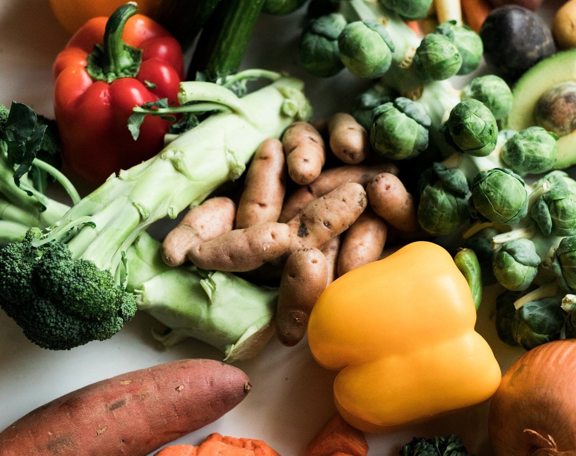
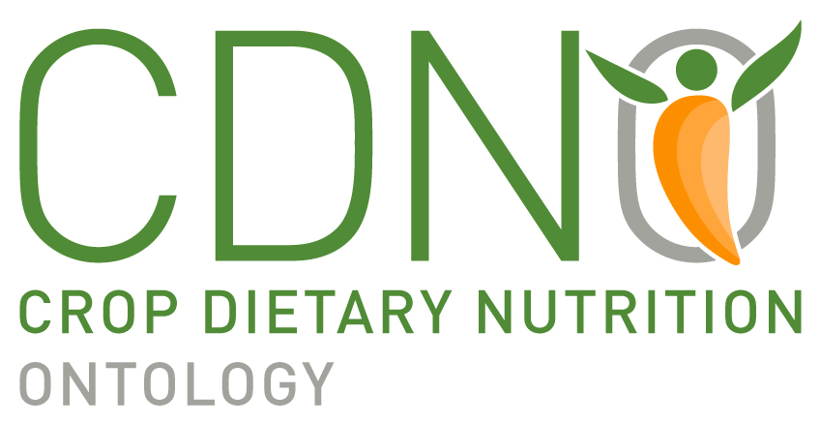
Progress and prospects for the Compositional Dietary Nutrition Ontology
Liliana Andrés-Hernández, Kai Blumberg, Damion Dooley, Britt Burton-Freeman, Paul Magelli, Shavawn M. Forester, Graham J. King.

Slide 2
Progress

Slide 3






Classes
Concentration Of Dietary Chemical Component in material entity
Human
Dietary Role
has role
Nutritional Functional Attribute
Dietary Material Physical Attribute
inheres in
inheres in
Dietary Chemical Component
FoodOn
Chemical Food Component
Organismal source

Slide 4
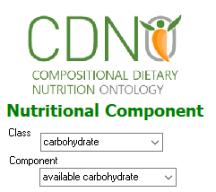
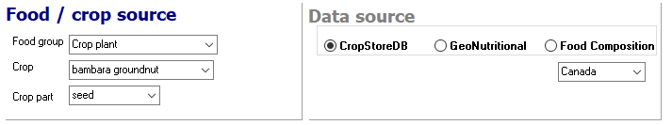
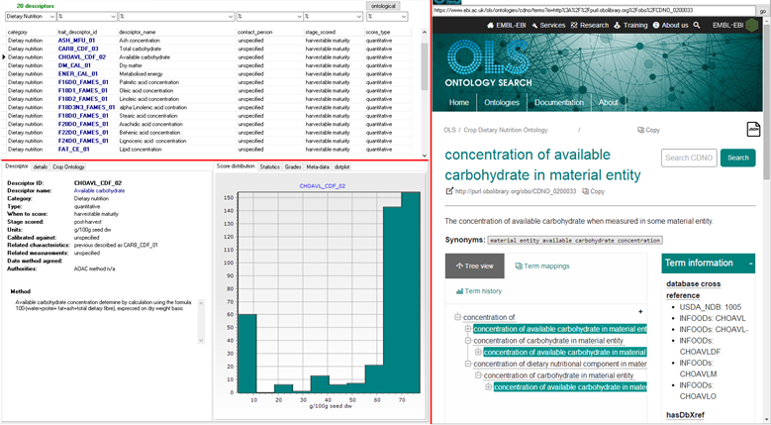
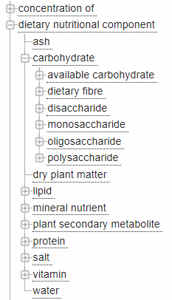
Online GUI and use-cases under development - multiple data sources
www.cdno.info
FoodOn
dietary chemical component

Slide 5
Classes
Concentration Of Dietary Chemical Component in material entity
Human
Dietary Role
has role
Nutritional Functional Attribute
Dietary Material Physical Attribute
inheres in
inheres in
Dietary Chemical Component
FoodOn
Chemical Food Component
Organismal source

Slide 6
10 upper level classes corresponding to proximate analysis: carbs, protein, fats…
604 assigned to CHEBI and ENVO
81 formally described in CDNO
4 releases
V3.2 the most recent version
Dietary nutritional chemical component
Is_a
Is_a
Is_a
Is_a
Is_a
Dietary Mineral nutrient
Protein
Carbohydrate
Secondary metabolite
Vitamin
180 mineral nutrients included
Terms such as dietary gold, dietary lead will be added under mineral non-nutrient class
10 proteins included
39 terms included
~350 terms to be included
Terms from Phytohub and PhenolExplorer
- In 2021, 25 terms were included.
Notes:
Structured terminologies to describe nutritional attributes of material entities that contribute to human diet.

Slide 7
Prospects

Slide 8

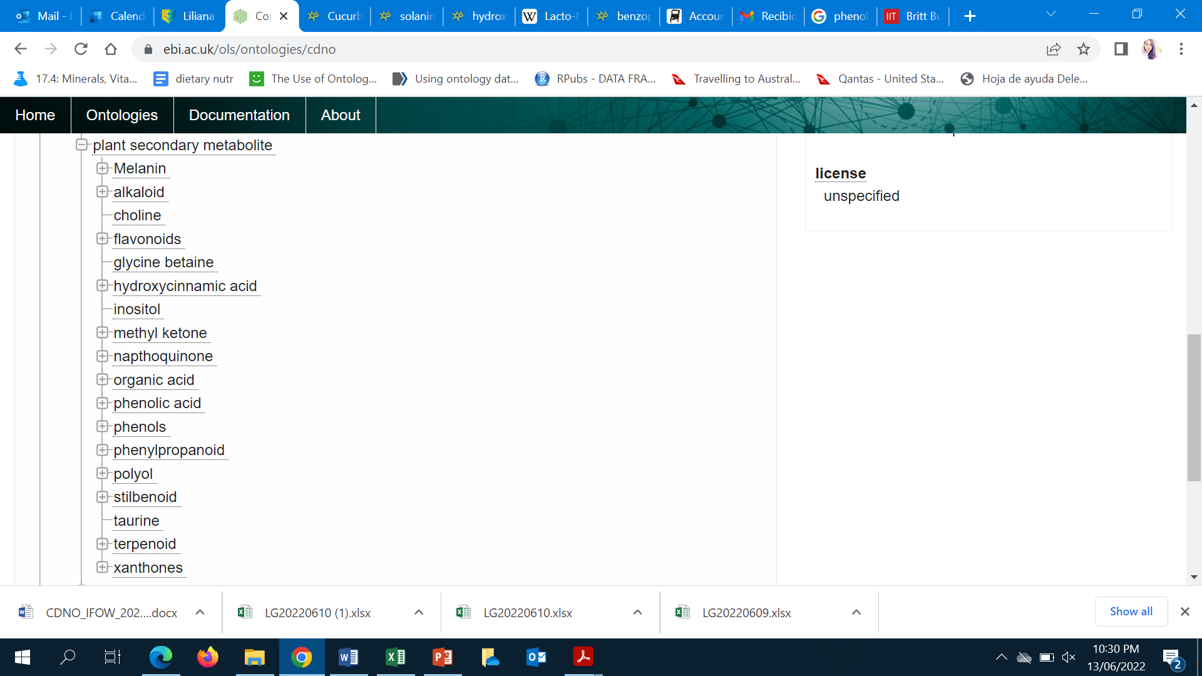


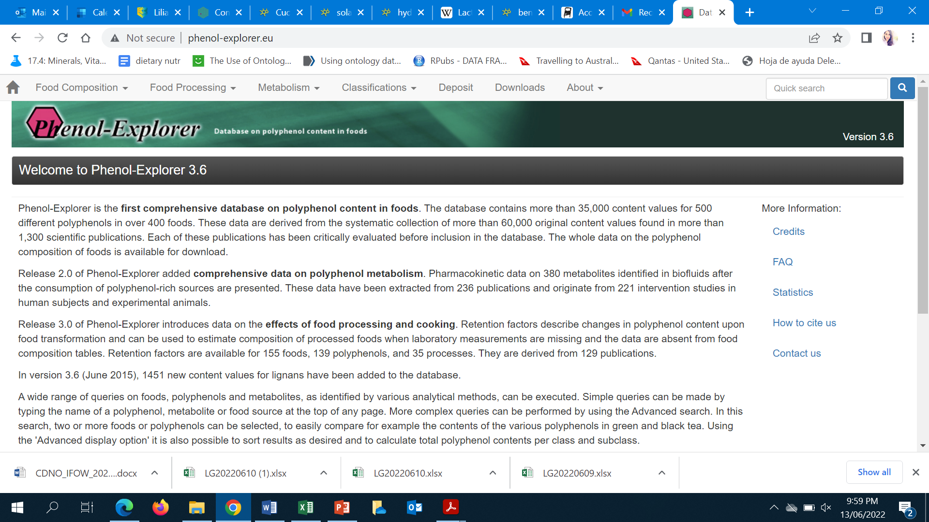

Secondary metabolites
Dr. Burton-Freeman
v3.0 of CDNO contains 277 secondary metabolites
~350 Phenol-Explorer, PhytoHub, ChEBI, E-numbers, USDA terms will be added in CDNO
~350 terms to be added in next releases

Slide 9
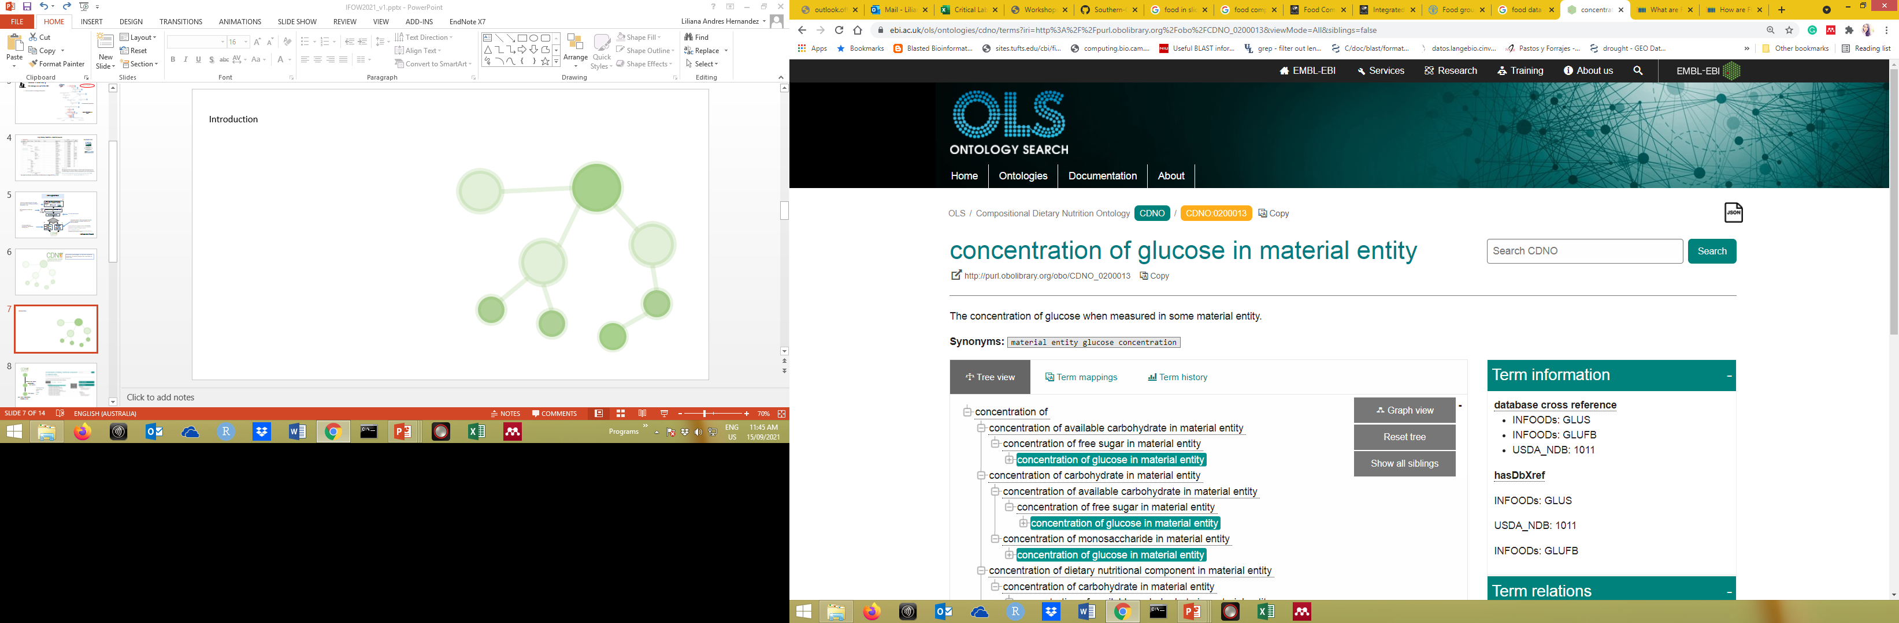
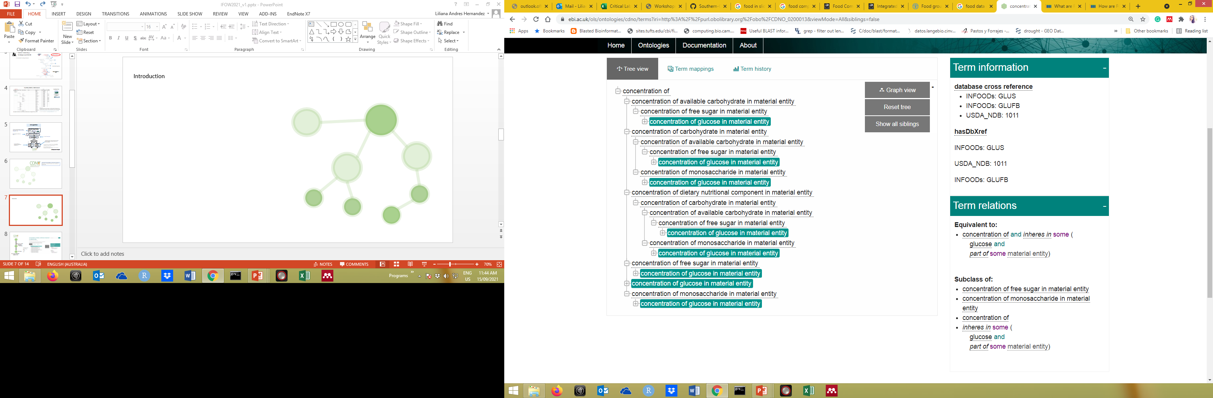
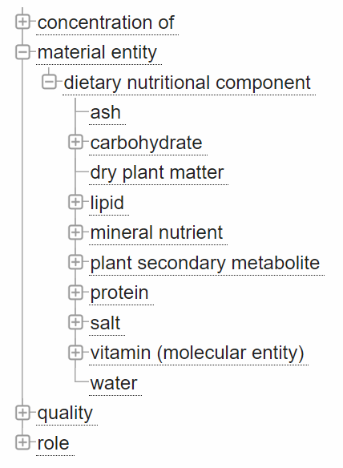
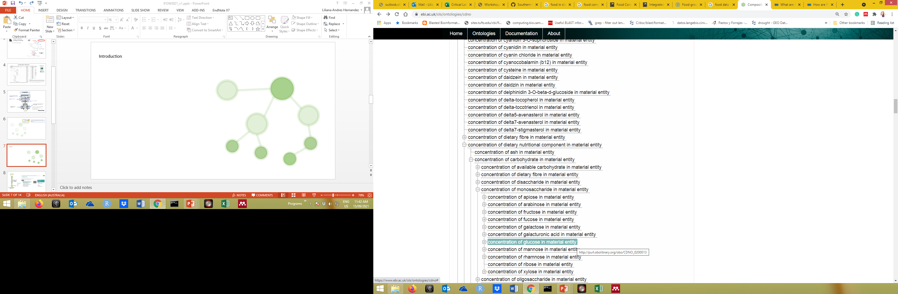



1005 | Carbohydrate, by difference
1050 | Carbohydrate, by summation
1123 | Lutein + zeaxanthin
1161 | cis-Lutein/Zeaxanthin
1008 | Energy

Slide 10
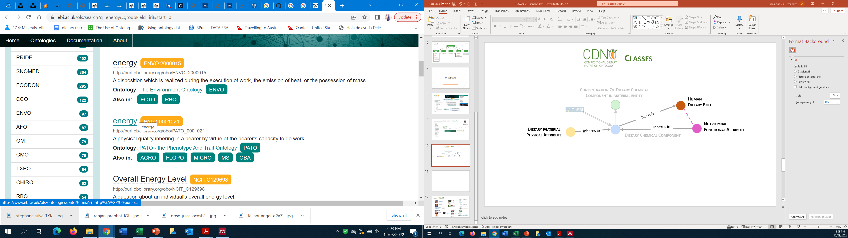
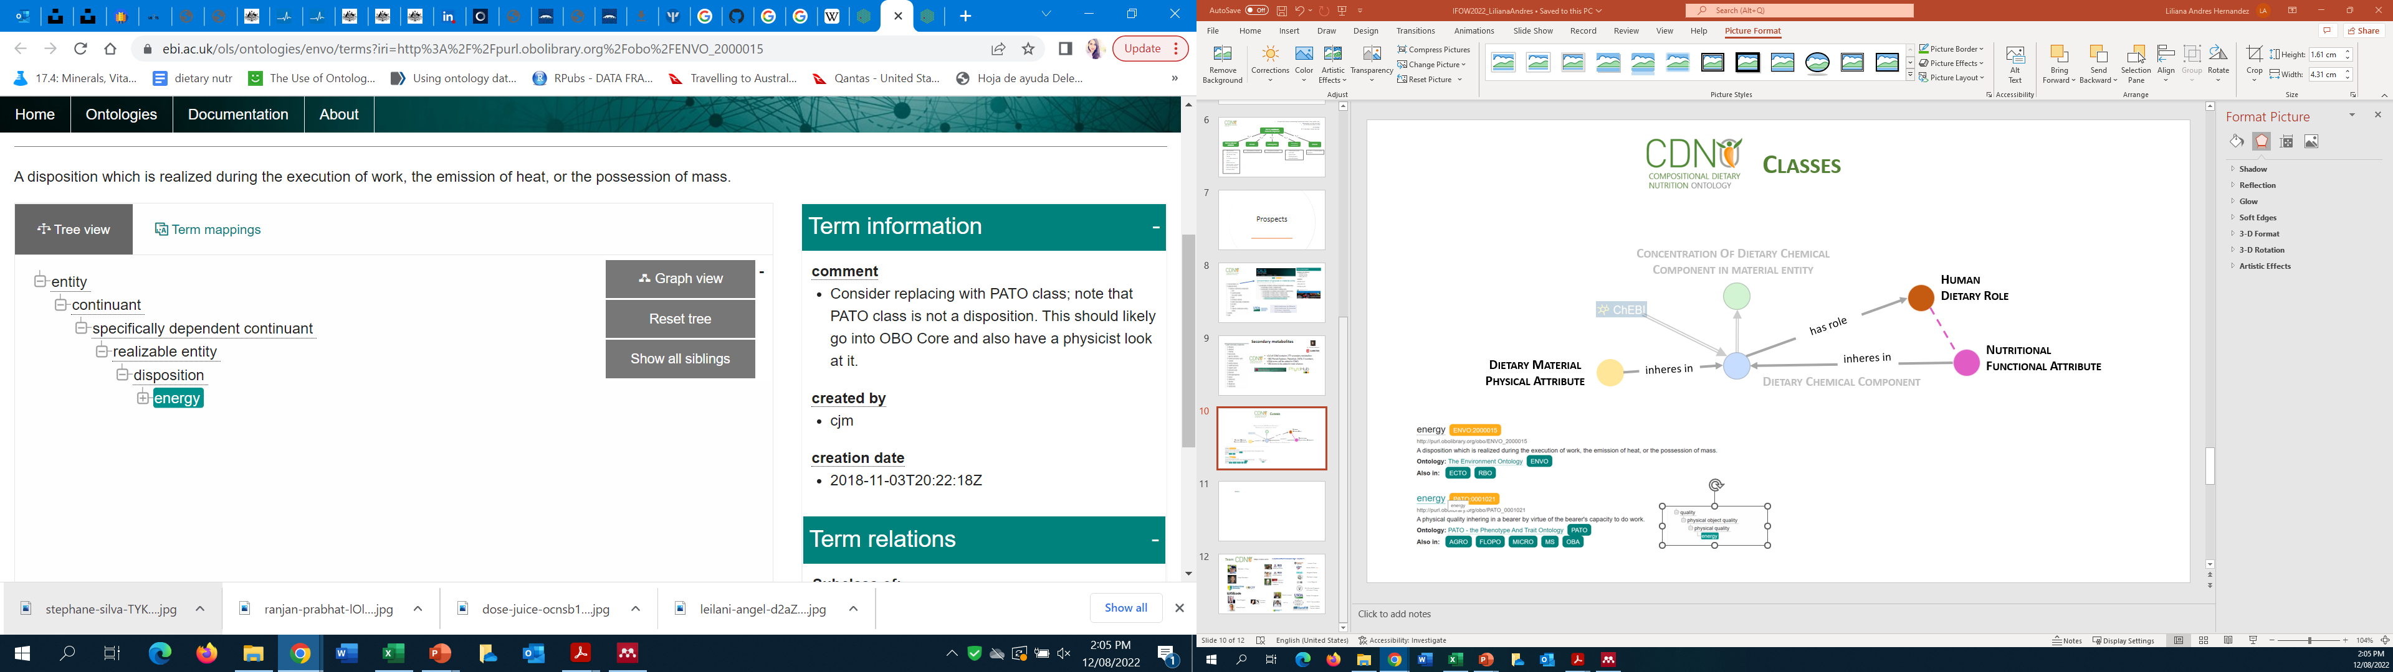
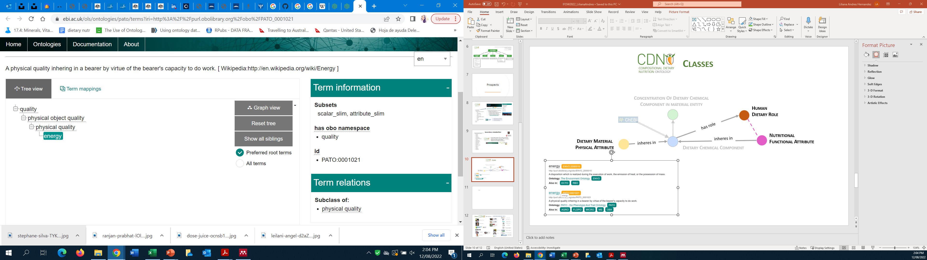
Classes
Concentration Of Dietary Chemical Component in material entity
Human
Dietary Role
has role
Nutritional Functional Attribute
Dietary Material Physical Attribute
inheres in
inheres in
Dietary Chemical Component

Slide 11
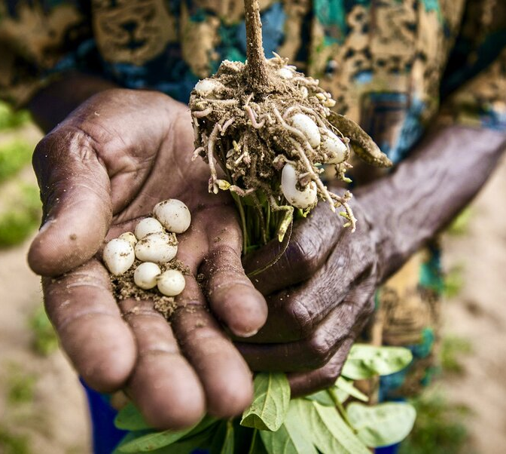
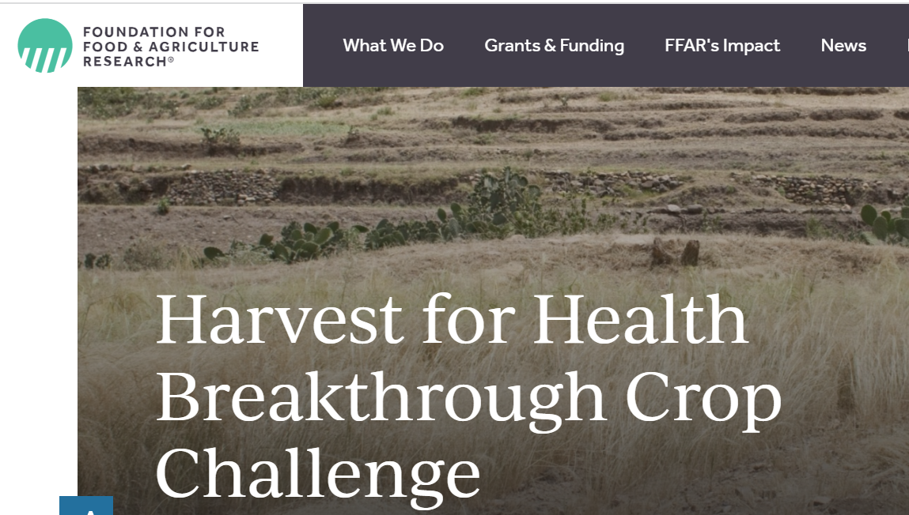
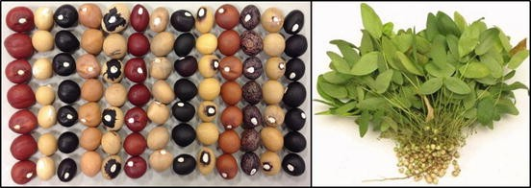

Grant application FFAR
FFAR partnered with the Global Alliance for Improved Nutrition (GAIN) to launch Harvest for Health initiative to accelerate the development of underutilized crops, increasing the diversity of foods in the marketplace.
Bambara groundnut (Vigna subterranea
Notes:
) is cultivated in the Sub-Saharan Africa’s desert. This underutilize drought resistant legume, has a nutritive value ranging between 57.9% to 61.7% carbohydrate and 24.0% to 25.5% protein content.

Slide 12



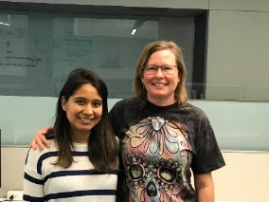


















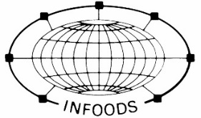



Team
https://cdno.info/
Collaborators/Knowledge sources
Lauren Chan
Adnan Malik EBI Magalie Weber
Matthew Lange
Lucia Segovia
Britt Burton-Freeman
Xuhuiqun Zhang
Graham J. King
Ramil Mauleon
Ramona Walls
Kai Blumberg
Damion Dooley
FoodOn
Razlin Azman
Naomi Fukagawa
Paul Magelli,
Shavawn Forester
Lei Liu
Ruth Charrondière
Mike Schmitt
Anders Møller /Jayne Ireland

